Slide 2
The brothers began their journey about the same time as me. Atlanta was ready to be crowned the southeastern jazz capital.

Slide 3
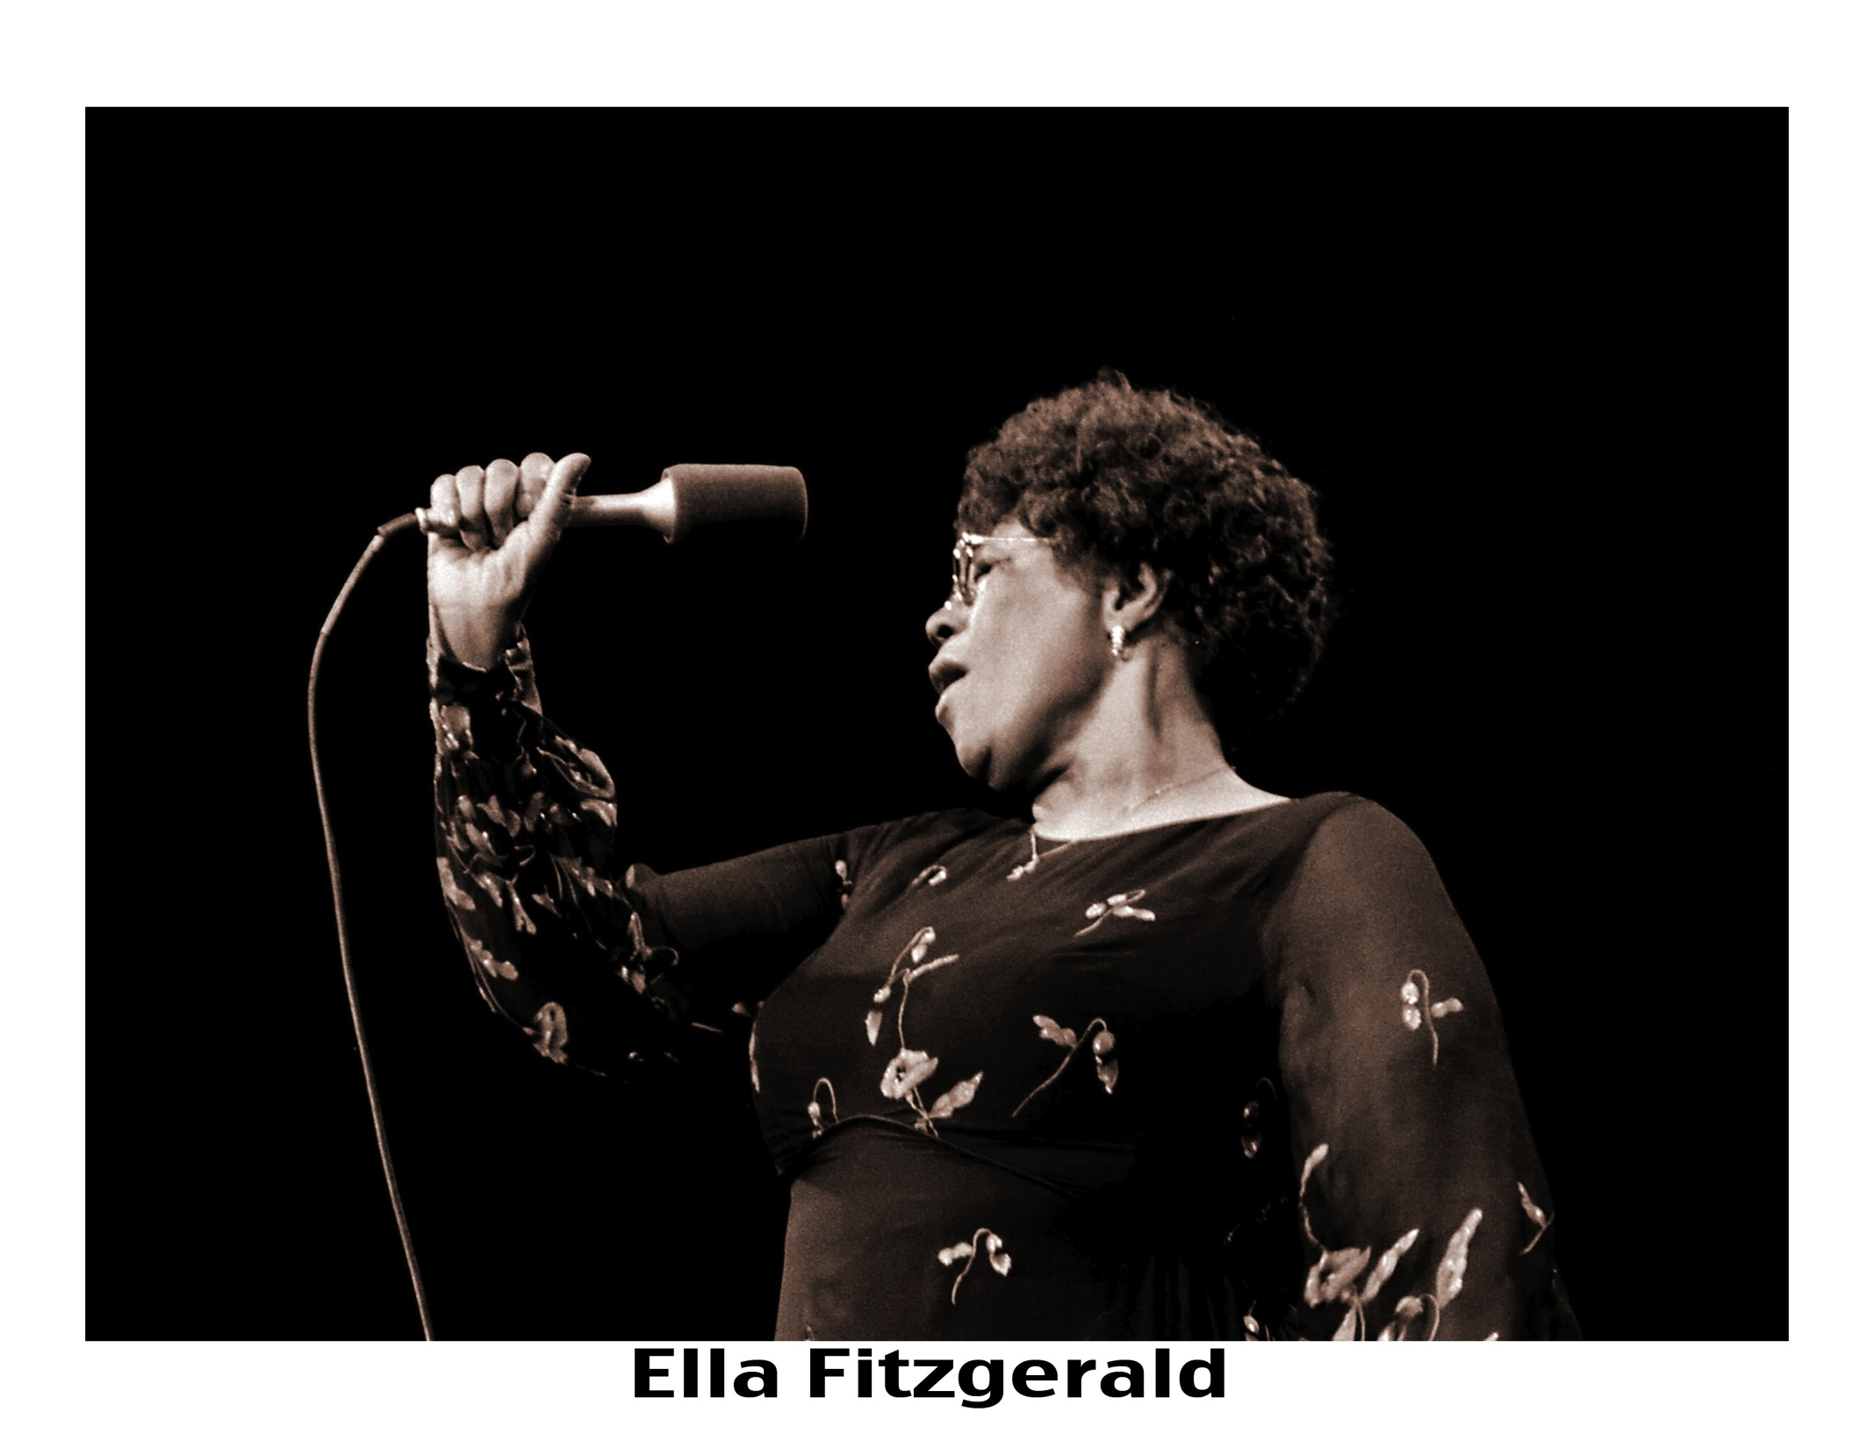

Slide 4
The King Preached the blues
to me in Atlanta
a pharoah played jazz

Slide 5
many greats and lots of fun in those early days
that voice is his instrument as my camera is mine

Slide 6
imagine my excitement photographing this legend
for the first but what was not to be the last time

Slide 9
a room with a view of the neighborhood about to be my own

Slide 10
LOCATION, LOCATION, LOCATION
Making music and photos in central park.

Slide 11
Friend and colleague, alfredo cruz from wbgo, called me to document this monumental moment. As they say,
“only in new york”!

Slide 12
Privilege and access: I met one in atlanta, we both moved to New york and several years later, I met and photographed the other southerner, campaign fundraising with his sax, later to become president!

Slide 13
then they met each other!

Slide 14
Not all is as it seems. Once upon a time when shooting film, unintentional double exposures might transpire. This was one hell of a lucky accident!

Slide 16
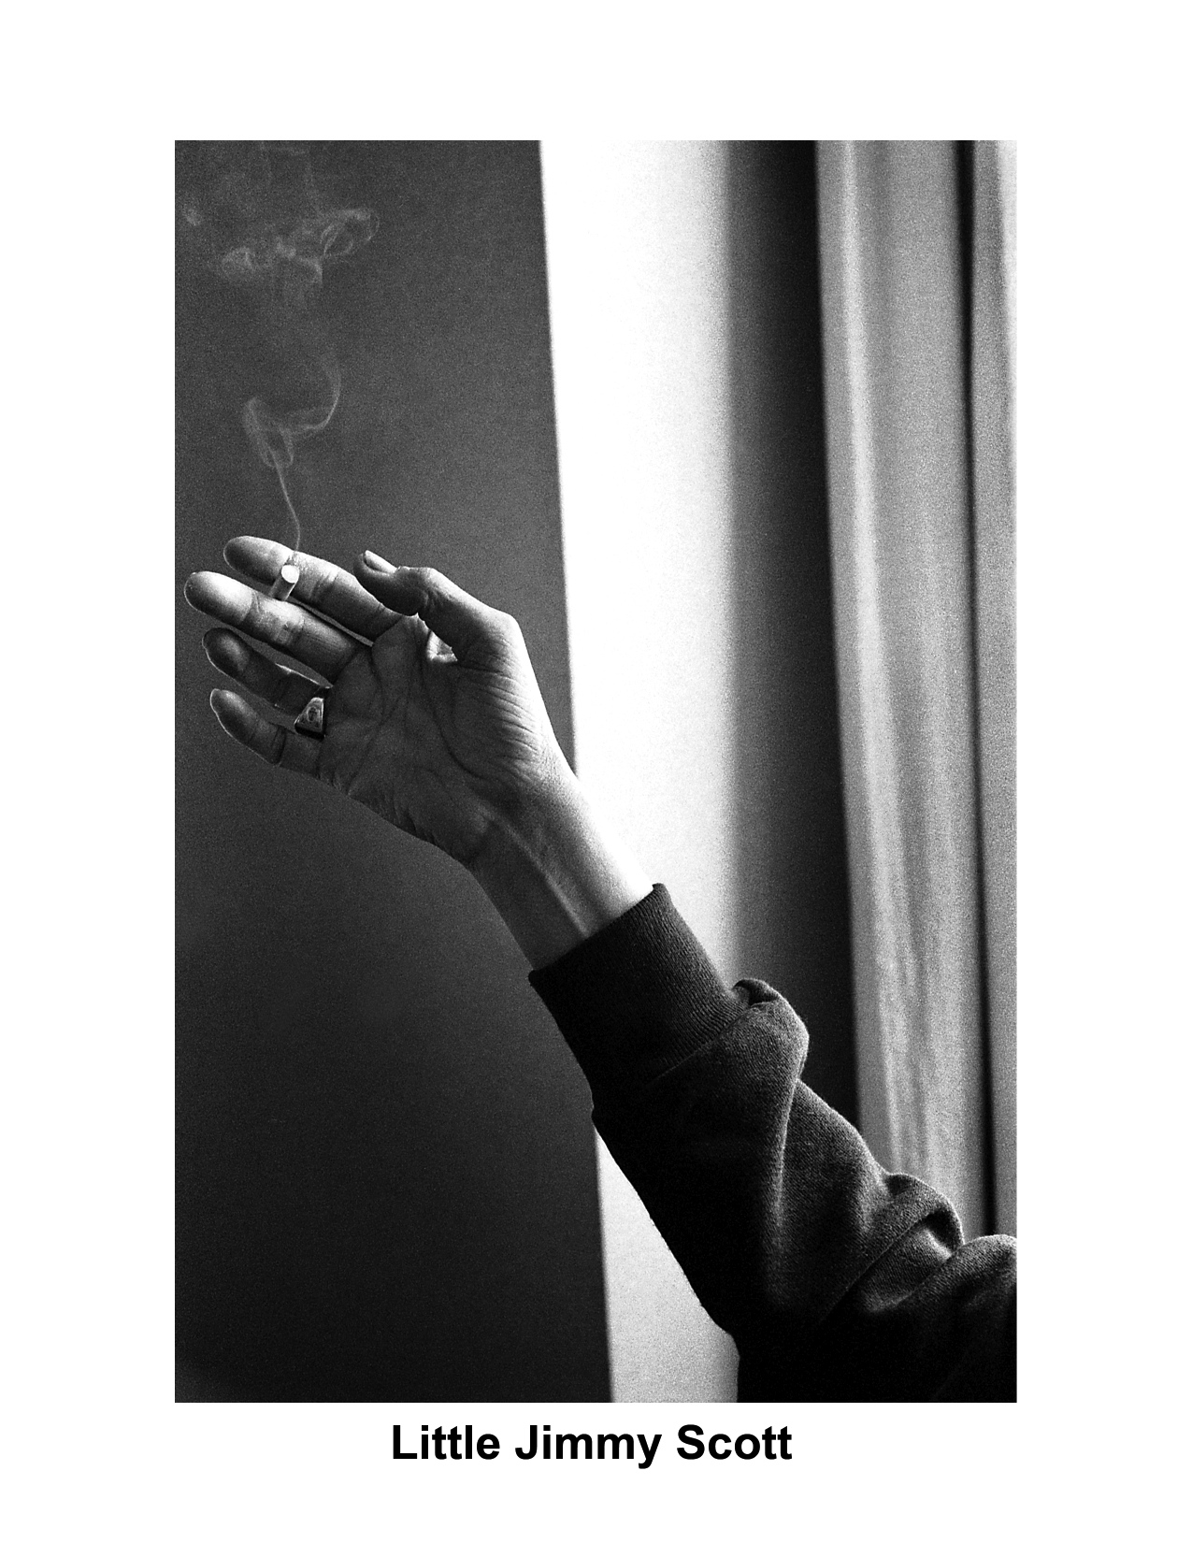

Slide 17
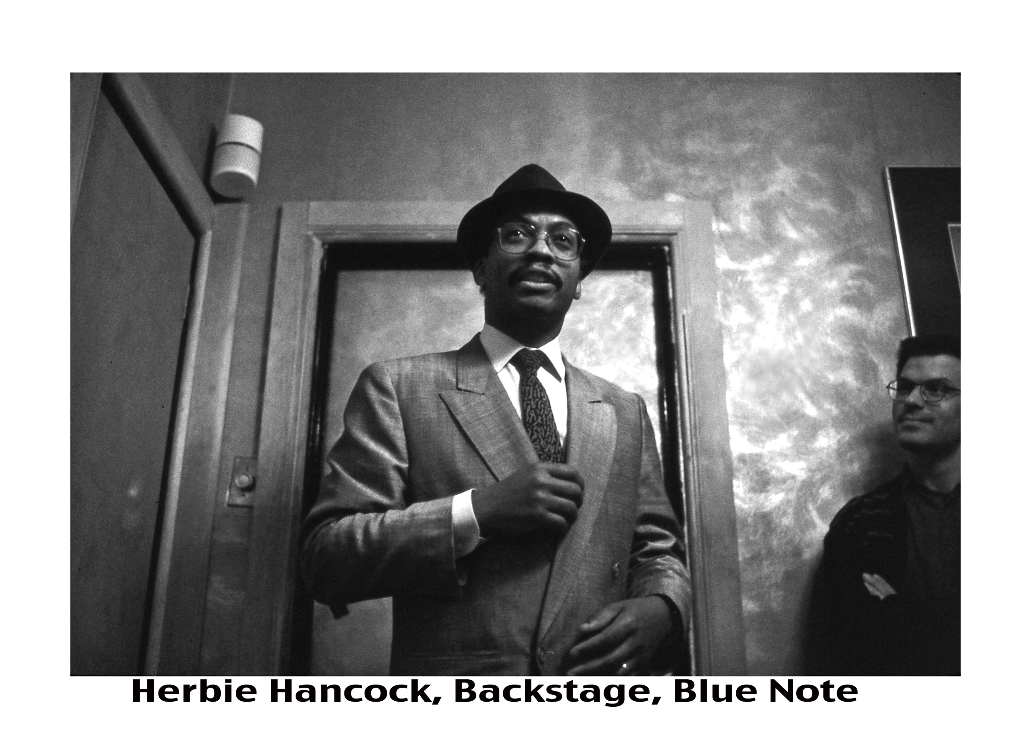

Slide 18
Free jazz, latin jazz, vocal jazz-one night in new york equals 365 days in some cities. There is one great reason to remain, and that is the abundance and variety of music…

Slide 19
Jazz is love, respect and devotion

Slide 20
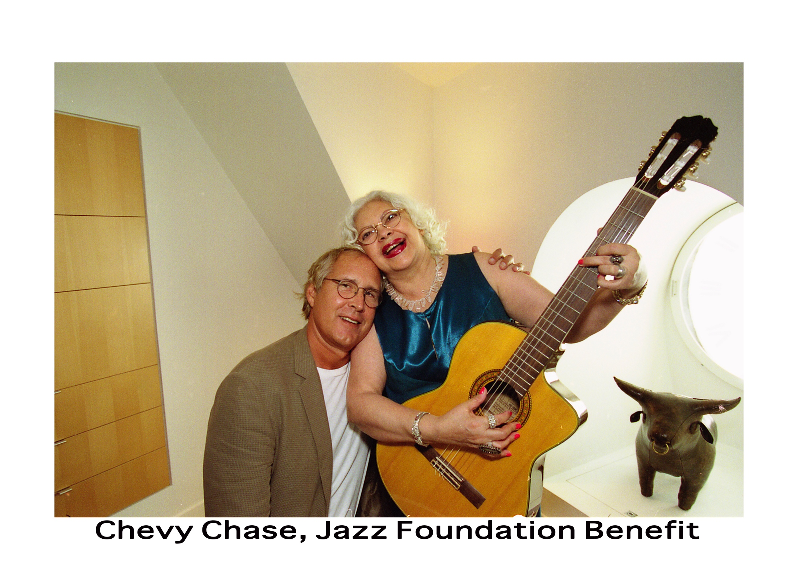

Slide 21
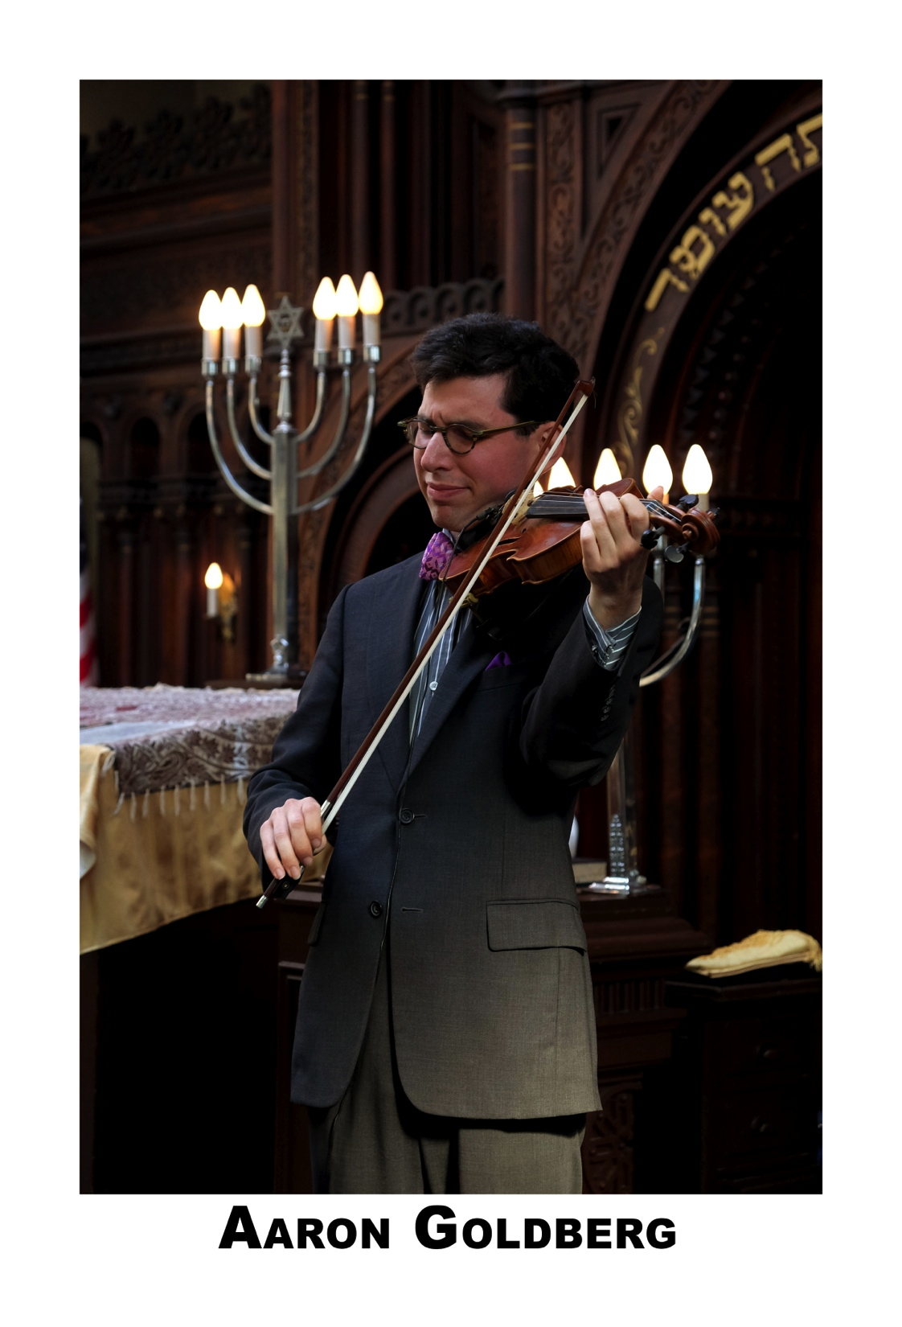
Like me, Jews in and of jazz

Slide 22
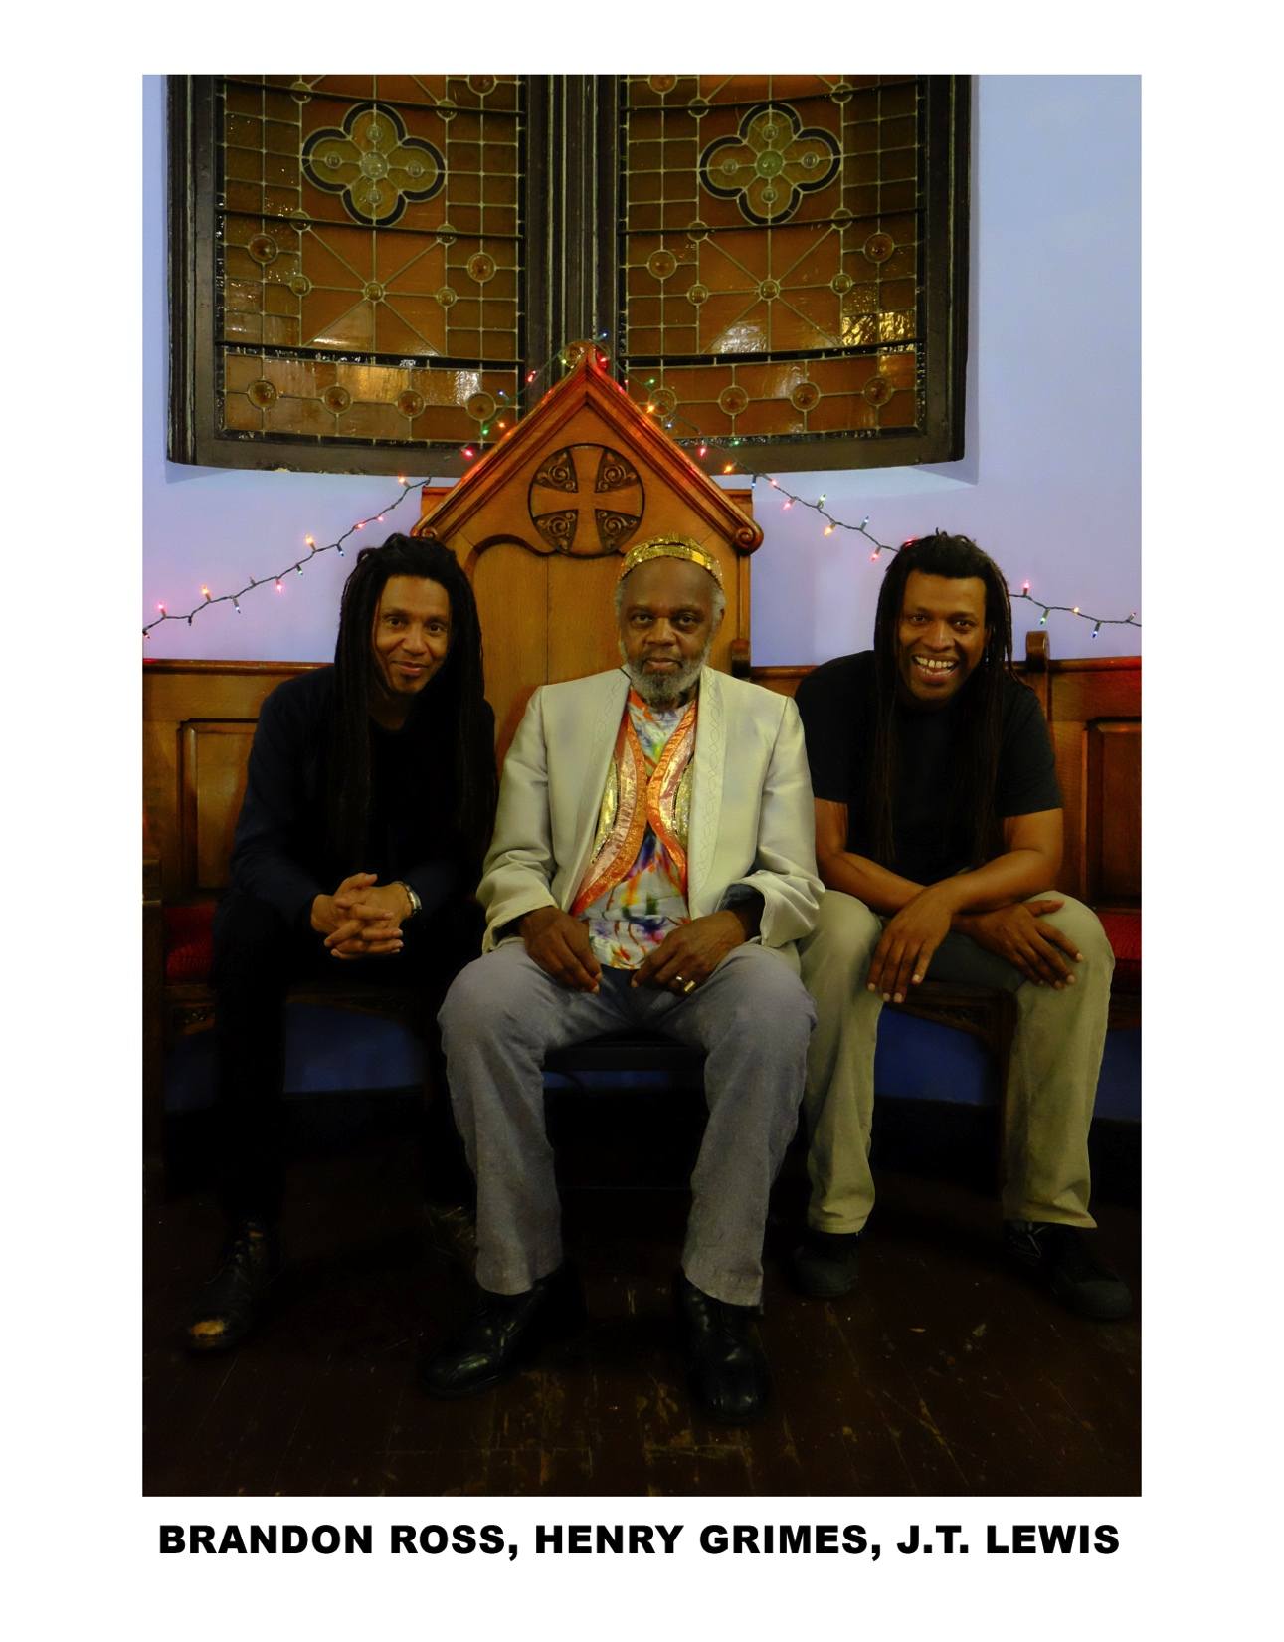
Six wise jazz men!

Slide 23
icons in front and back of the house

Slide 24
the avant garde visionaries gather once a year

Slide 26
it’s sonny everywhere

Slide 27
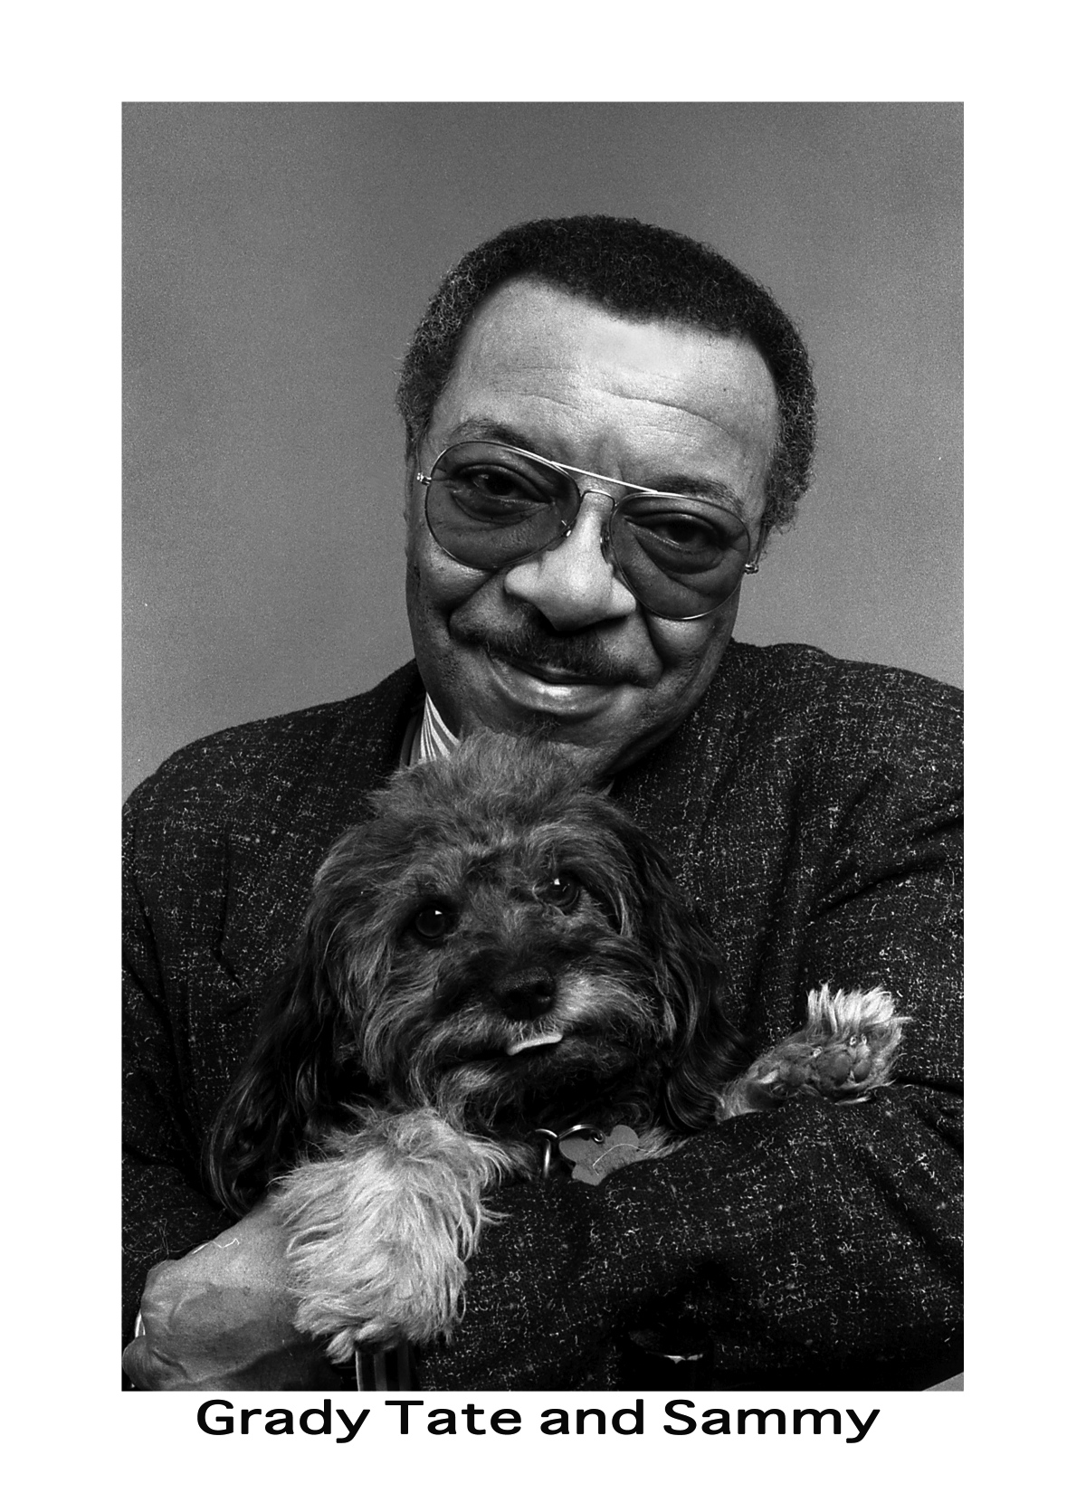
from sunny to funny!

Slide 28
jazz is style and great hair!

Slide 29
Jazz funerals in new york are incomparable slices of history

Slide 32
The power and emotion of songstresses!

Slide 33
the expressiveness of hands & the emotion of the singers

Slide 34
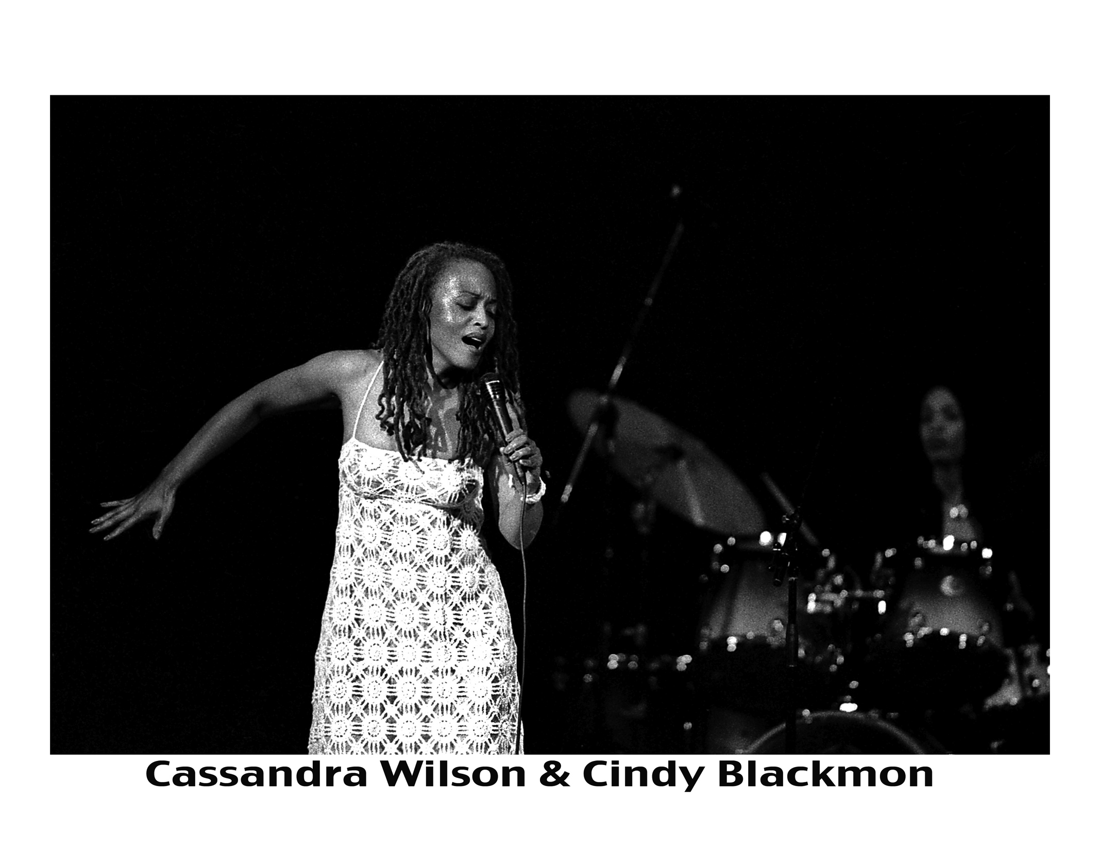
Definitely not just
a man’s domain

Slide 37
Hanging with the best

Slide 39
The inner life of these artists revealed in their homes

Slide 40
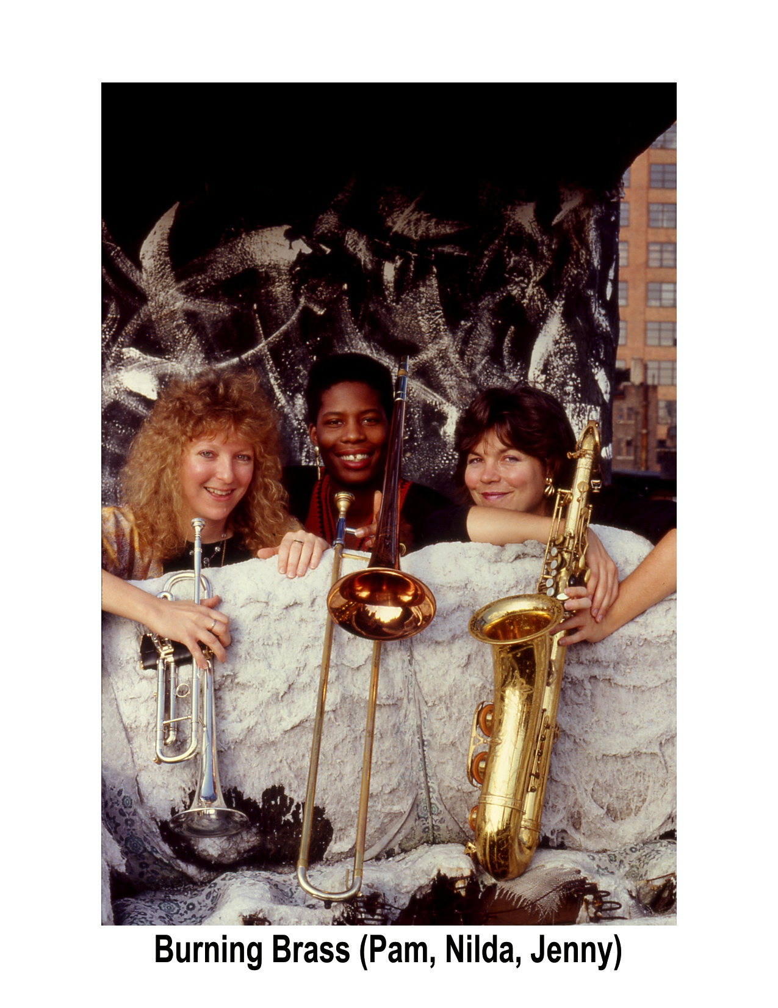

Slide 42
Deep in my archives, are photos of savion from the very onset
of his career and fame, but accessing those files can be complicated in small new york apartments.

Slide 44
Before carlos, she was just cindy!

Slide 45
Never ever too much of cassandra

Slide 46
Sometimes there are so many good photos from one subject, or one shoot or one night, that I am compelled to create a montage, my own version of a mini photo essay/pictorial.

Slide 47
Statuesque women of jazz

Slide 49
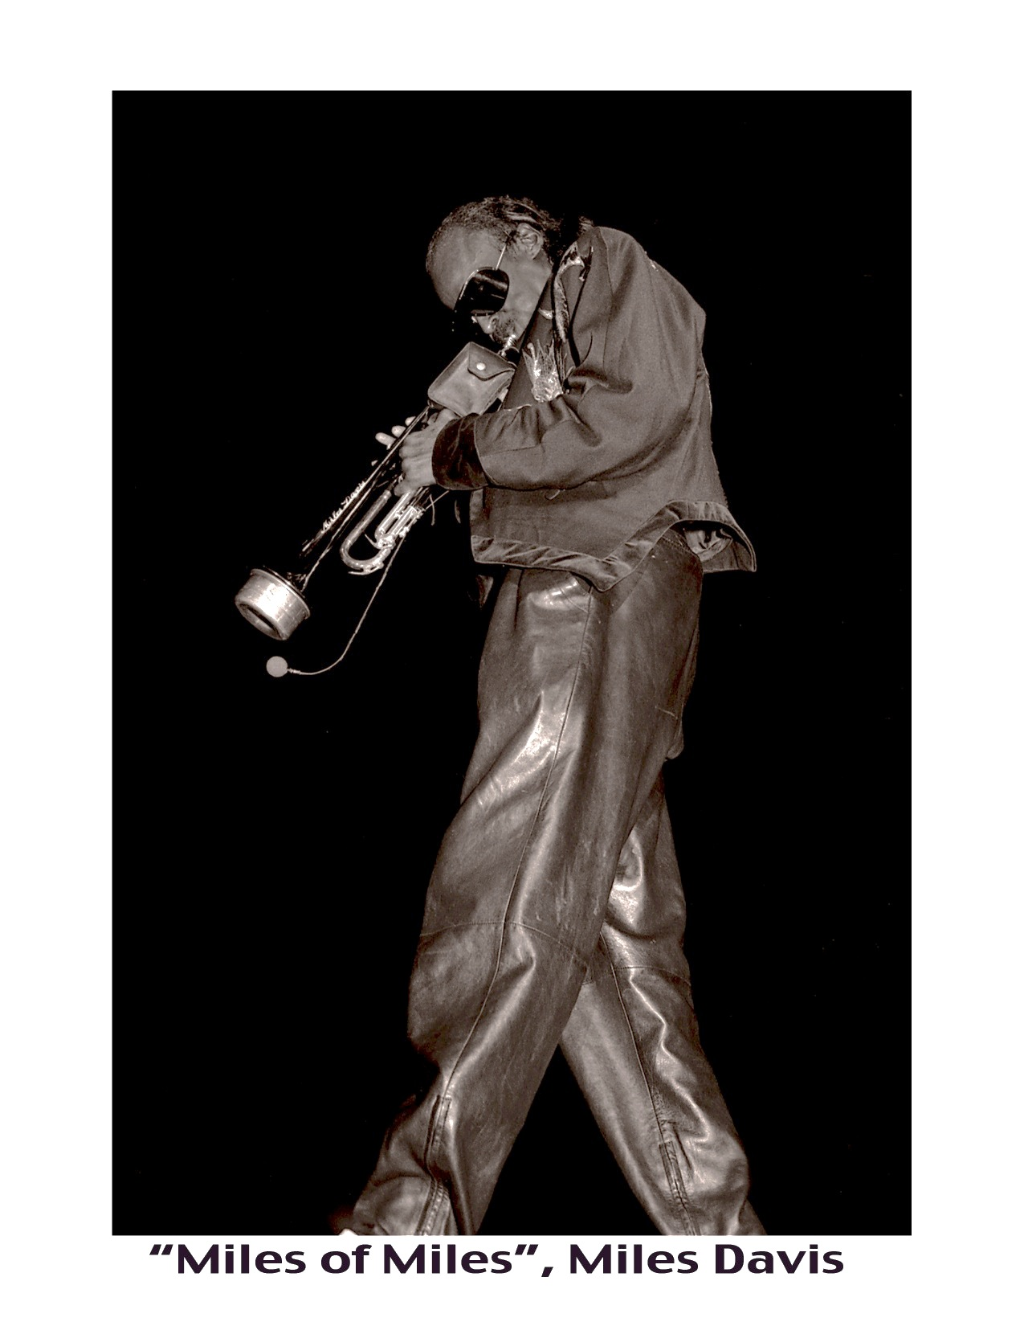
Twice was not nearly enough to photograph, see, listen to this legend, but that my own trajectory began at the end of the time alloted for many of the greats, was nothing more than a blessing.

Slide 51
But Dizzy was different, I was fortunate to fotograph him many times more than Miles, including at the memorial of Miles in New york city.

Slide 52
As was the case with tito,
I was there with my camera,
many times, on many occasions, him with various other legends, backstage, onstage, all over the great city of new york.

Slide 53
Twice My camera landed
on ray charles, first in 1983, secondly in 2003, exactly, according to my math, twenty years apart!

Slide 54
The magic, mystery and mastery of jazz,
mostly experienced at night, in the dimly lit clubs that dare to be different.

Slide 55
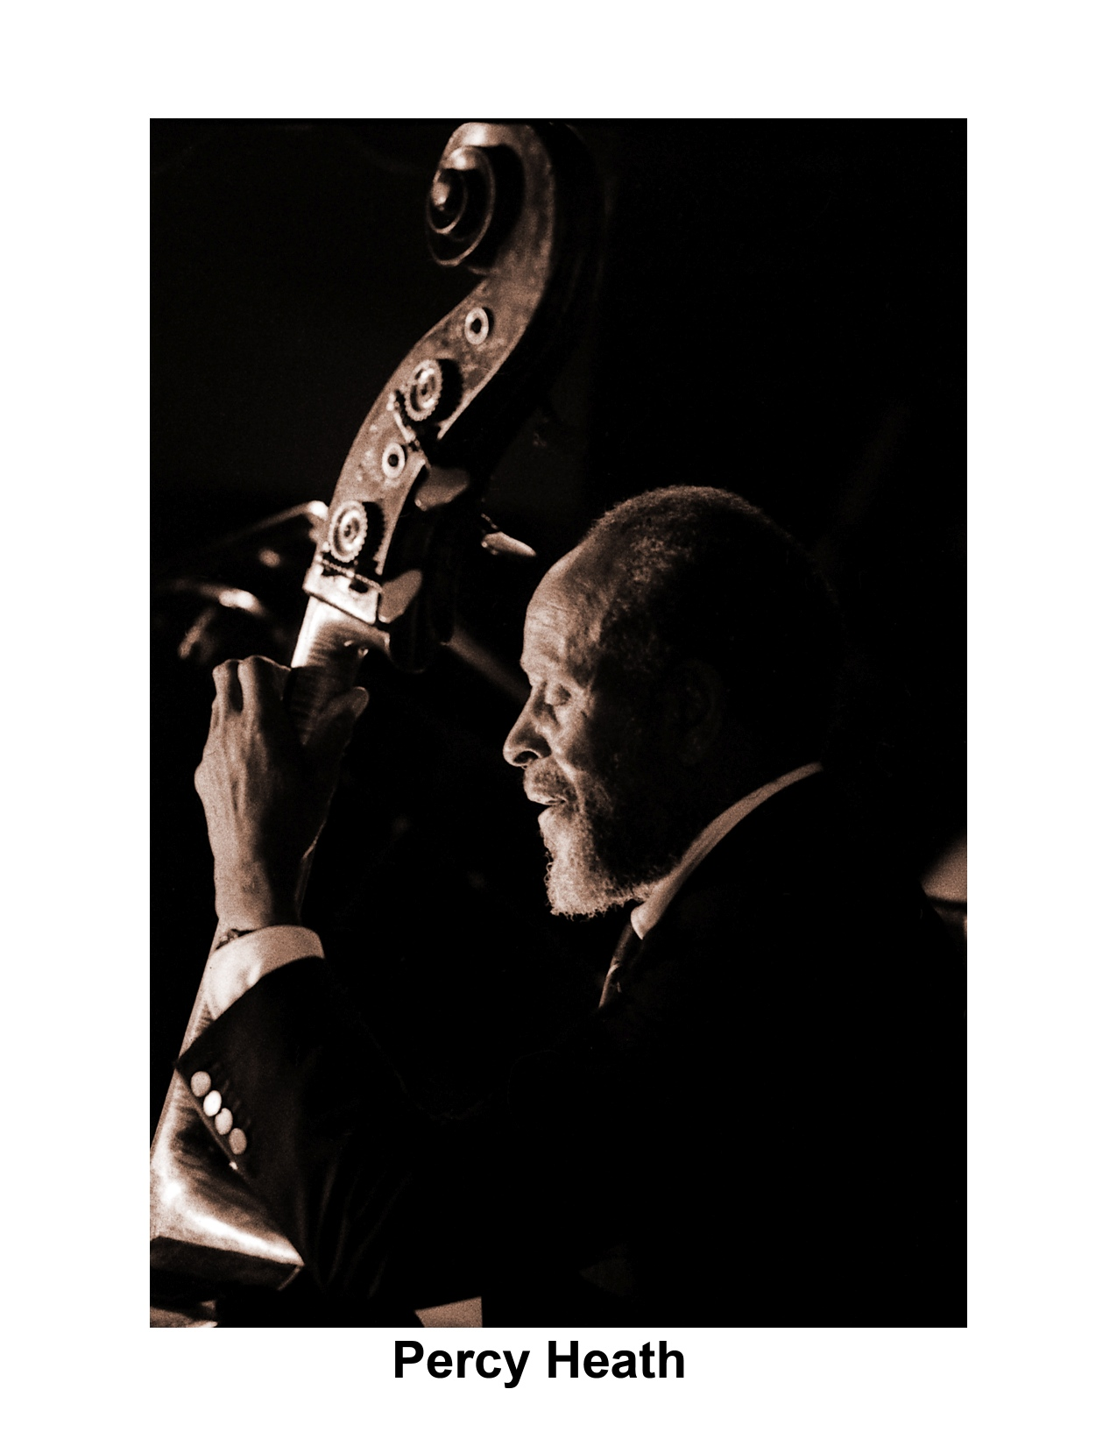
Elegance and jazz are most definitely perfectly aligned.

Slide 56
Personification of a perfect gentleman and pianist of jazz

Slide 57
my camera always wishes to know what are they thinking, feeling, expressing. Is it open to interpretation?

Slide 58
Some you may not have heard of, were not household names, but they should be known, they were as deserving as some that are, if not more…

Slide 59
Por ejemplo (for example), these two brilliant pianists, should be known.

Slide 60
In jazz, some are simply known by their first names. If you are referring to one of the greatest drummers of all time, all you need to say is “elvin”!

Slide 61
Same rule applies to max roach, one of those other greatest ever drummers. Simply “Max” will suffice.

Slide 62
mutual admiration society amongst these greatest of drummers and legends of jazz.

Slide 63
Just go to any jazz club, converse with any jazz historian or journalist or fan and all you need to say is “Jaco”. They will tell you stories that will make your head spin.

Slide 64
Speaking of historians and musicians and television personalities, Billy taylor was all those and more, wrapped into one helluva legend.

Slide 65
Just because clarence was in one of the greatest rock bands (Springsteen’s e-street), doesn’t mean he didn’t play a mean jazz saxophone as well as sing some blues…

Slide 66
As for jazz clubs, none was/is as legendary as the village vanguard and the owner lorraine gordon who became it’s controversial proprietor after her husband max gordon died.

Slide 67
And someone who played there often, pictured in the former photo with Lorraine gordon, was illinois jacquet and his big band.
Then one day, I went to his home in jamaica, queens, home of the louis armstrong museum, and photographed him in his car!

Slide 68
Sometimes they looked at my photos when I photographed them…
…other times they lied on the floor to pose for me.

Slide 69
backstage

Slide 70
All gone, but never forgotten

Slide 71
Les paul appeared every monday night for years, at another jazz club, newer than the vanguard, birdland, et al, but host to many legends.

Slide 72
Way different music, but kinda kindred spirits.

Slide 73
The late nights and long days, took their toll.

Slide 74
A pianist prays for peace

Slide 75
A wife comforts her dying husband, another one we lost way too soon.

Slide 76
this man’s music lives on through his records
and his son chico freeman...

Slide 77
The time to wave goodbye was fast approaching

Slide 78
As the music lifts us, the heavens await the legends

Slide 80
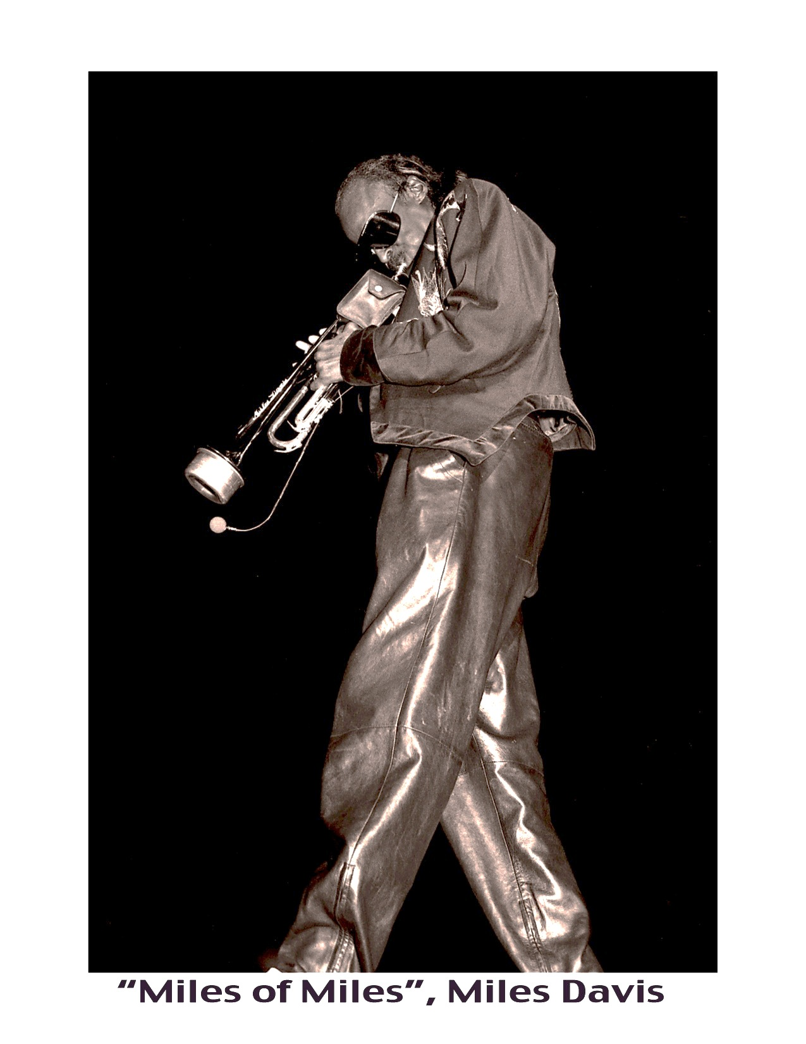
before and after

Slide 87
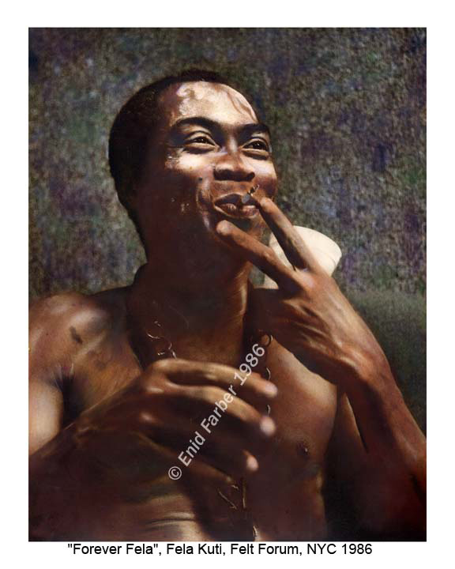

Slide 88
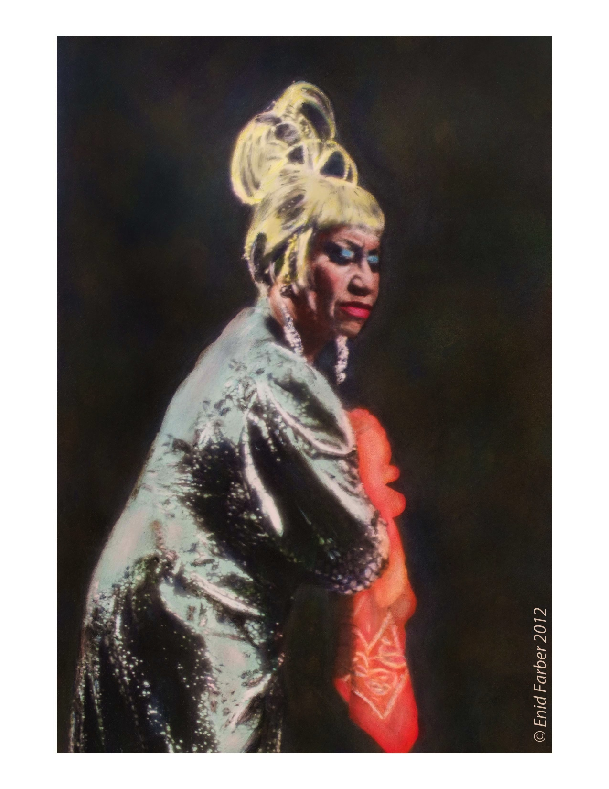

Slide 92
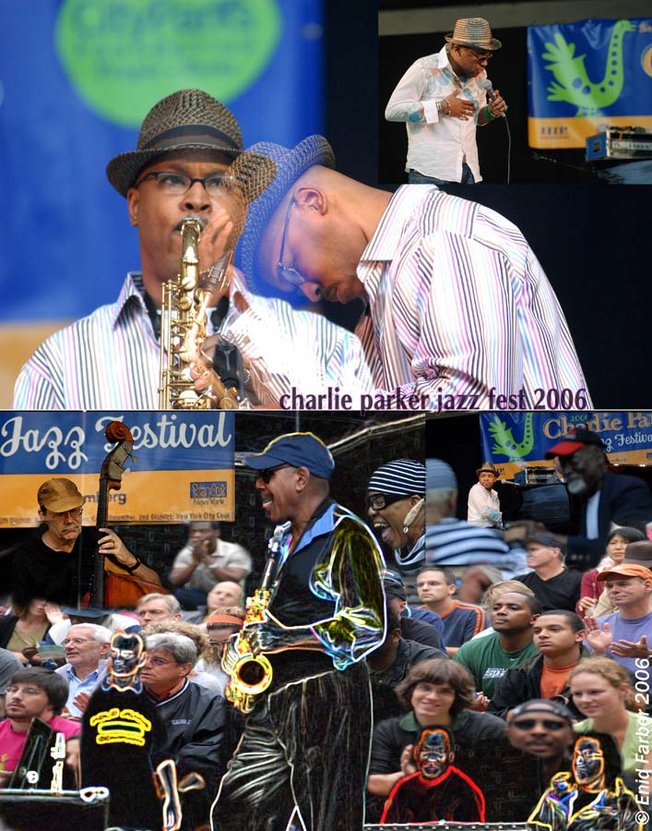

Slide 94
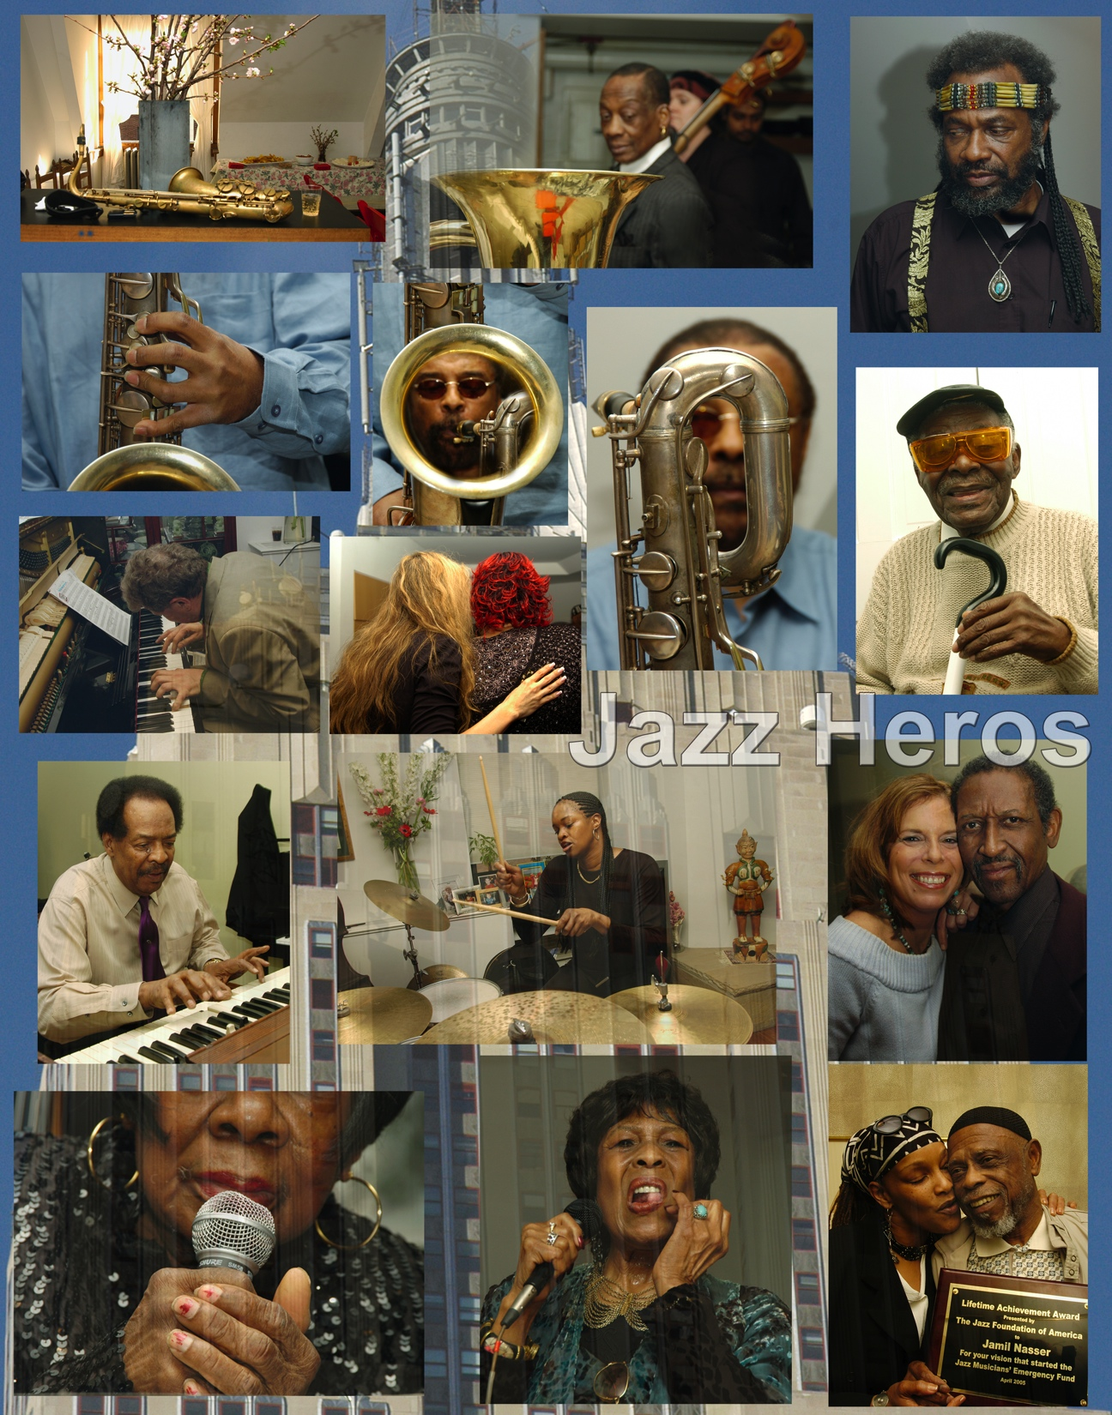

Slide 95
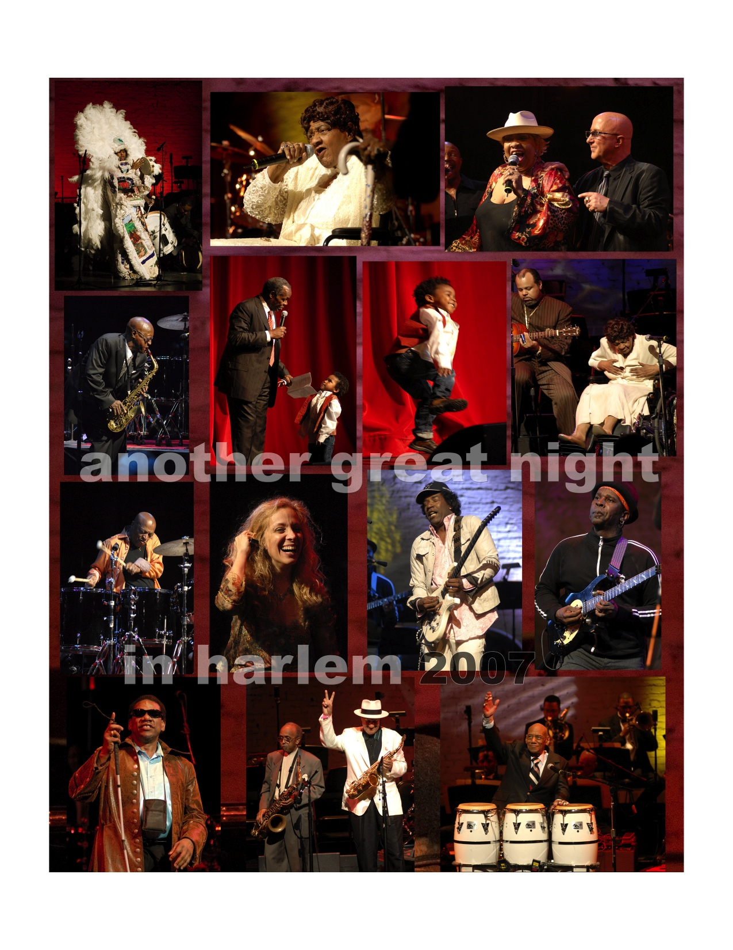

Slide 96
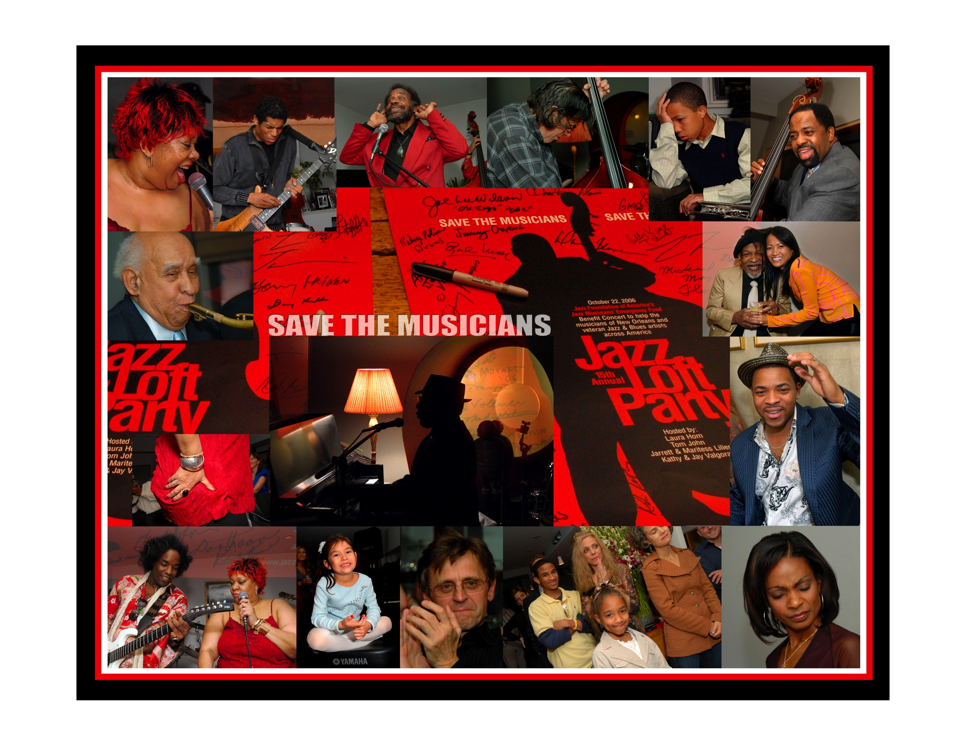

Slide 97
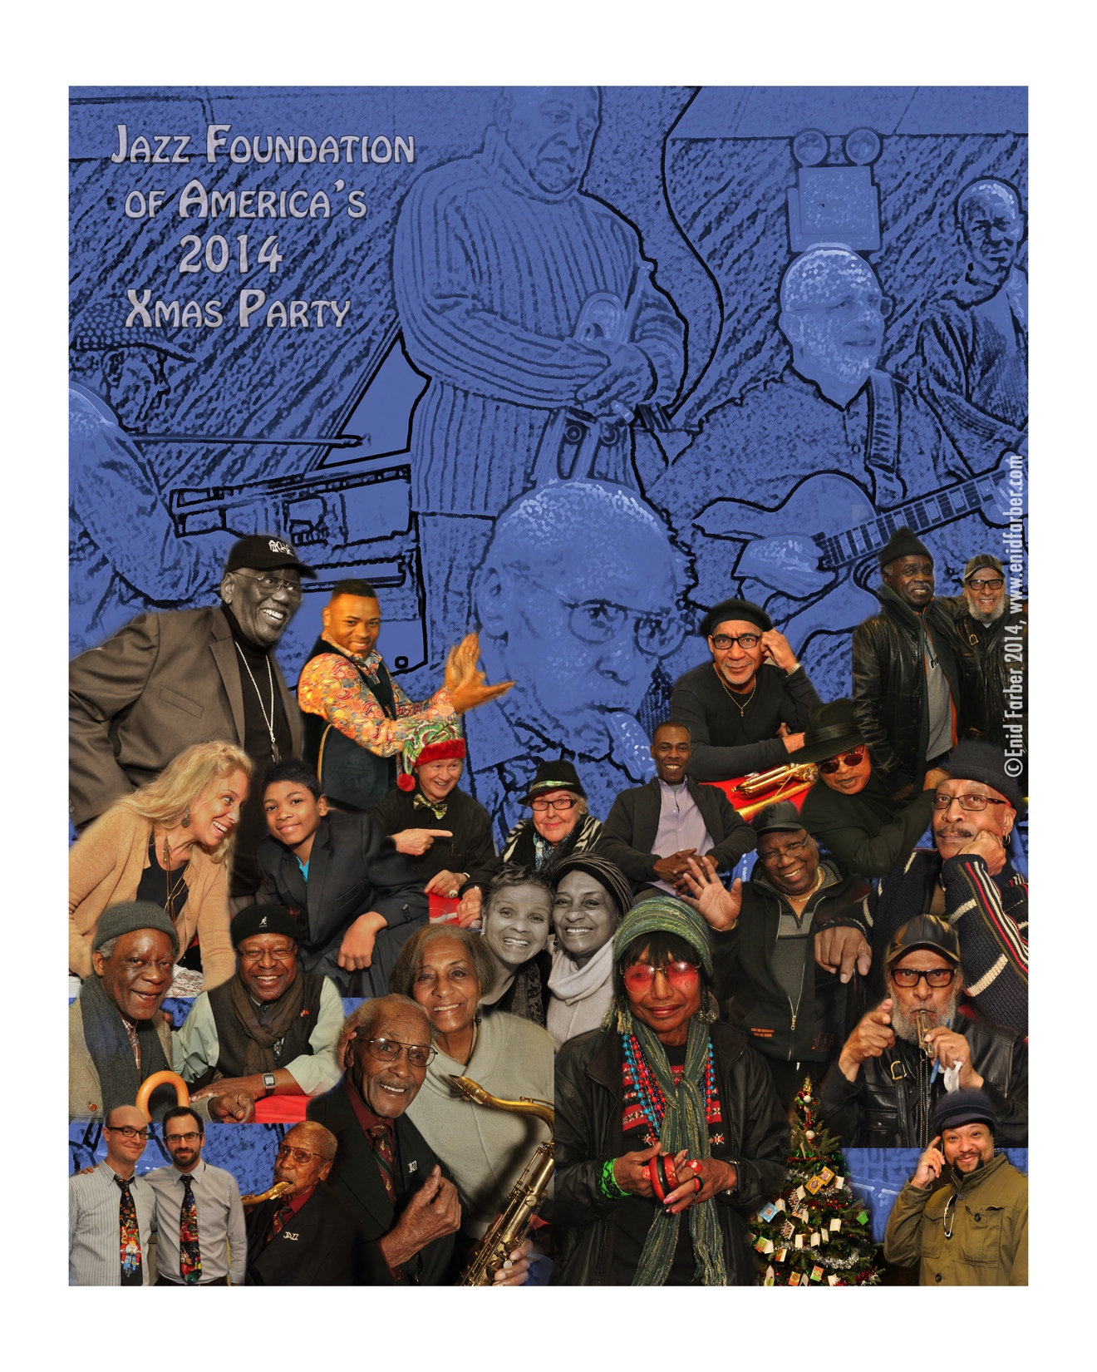

Slide 98
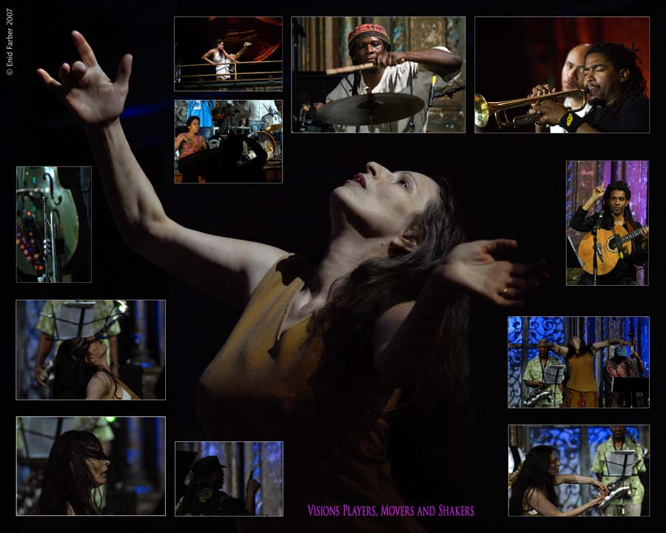

Slide 99
many thanks!
enid

Slide 100
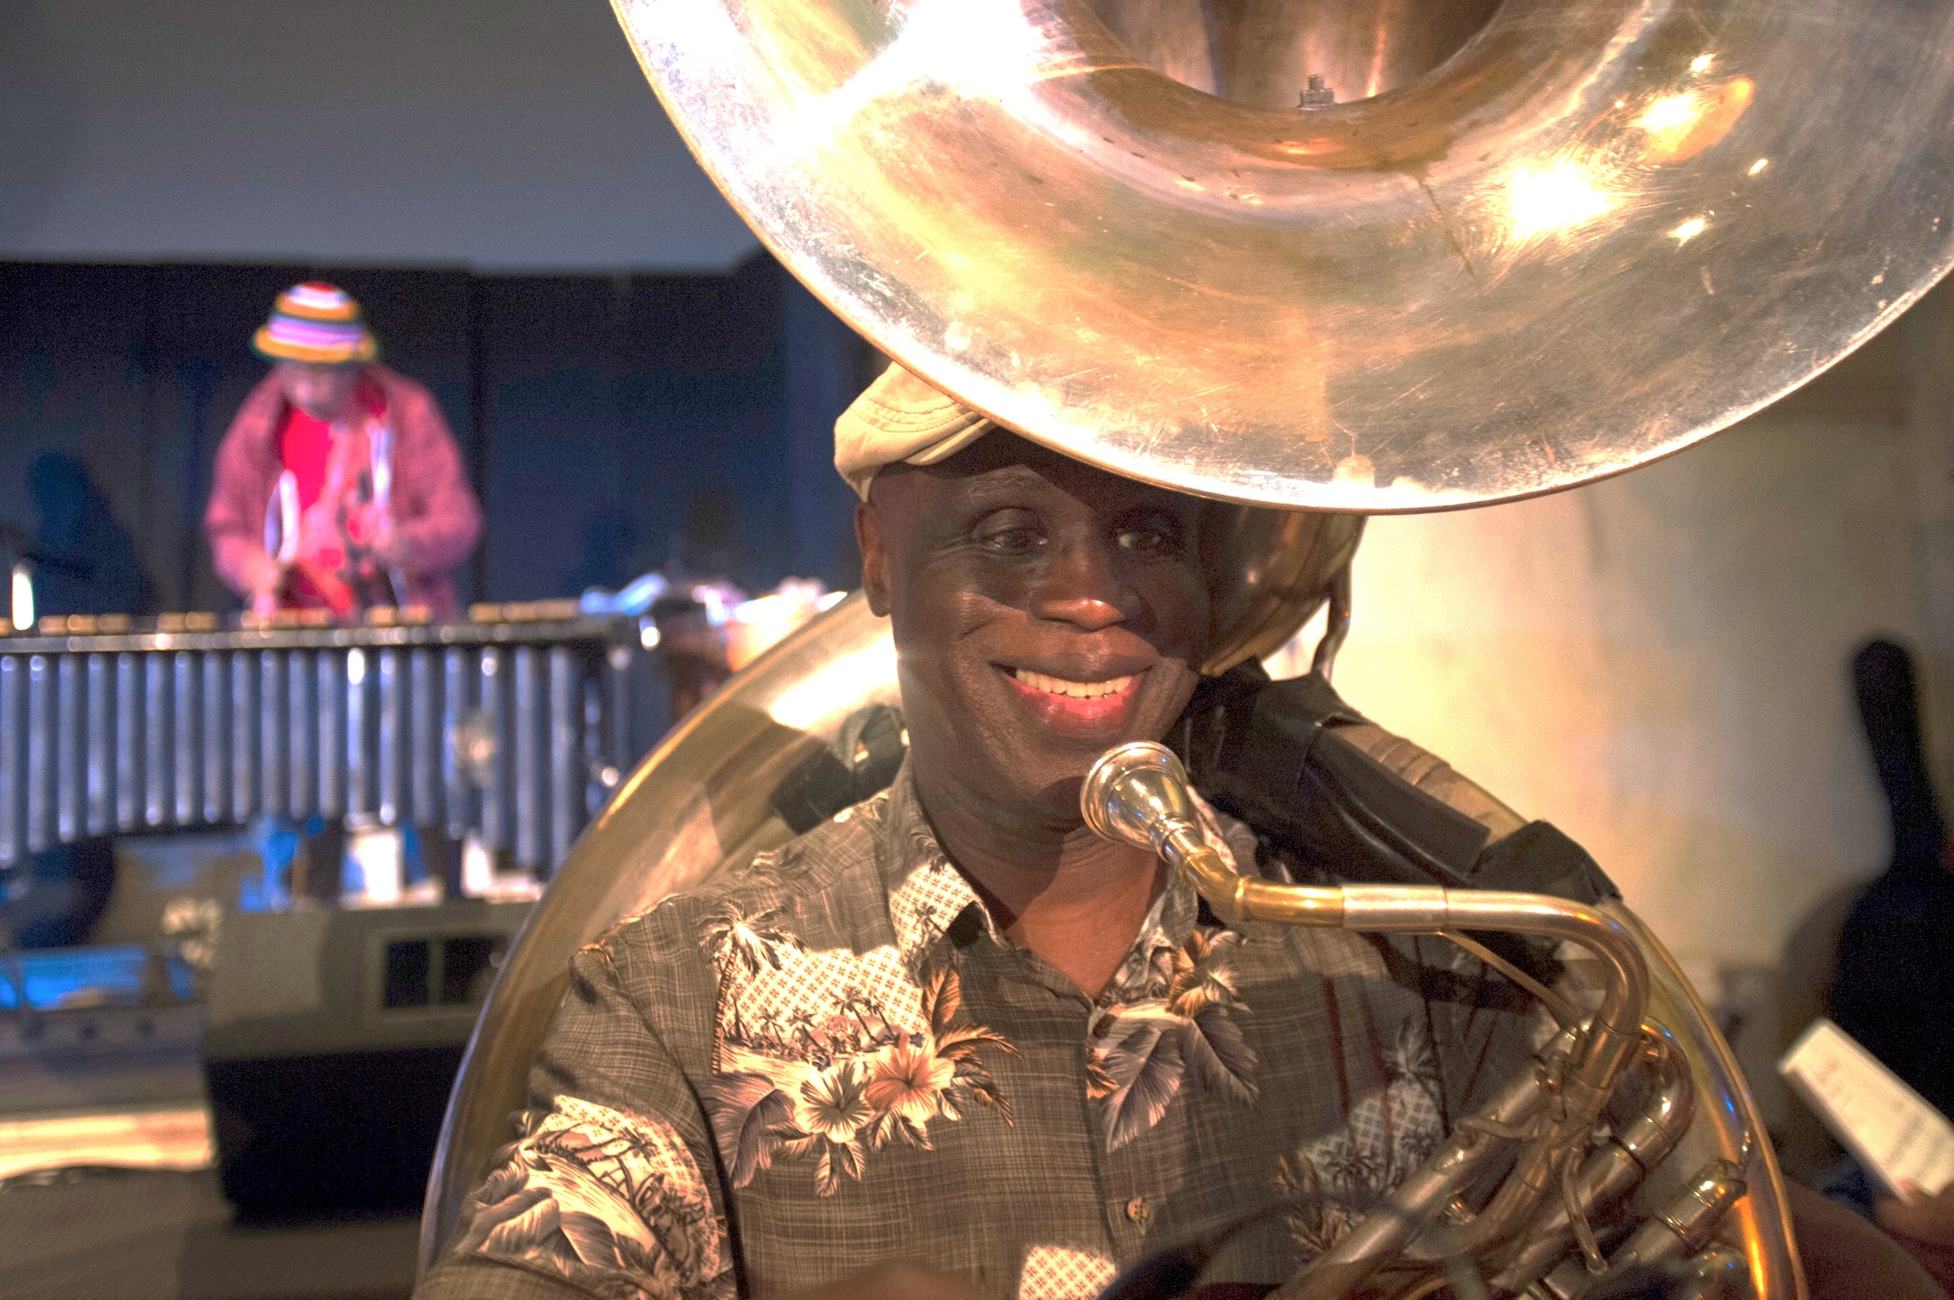
Music credits
1) george adams & don pullen, “sun watchers”
2) lila downs, “naila”
3) ondine darcyl, “black orpheus”
4) queen latifah, “i’m gonna live till I die”
5) olu dara, “your lips”

